Slide 1
Developing Renewable Technologies
Proposed Wind and Solar Project
Done By: Anelda Maynard-Date

Slide 2
OBJECTIVES
Types of Renewable Energy available to St. Kitts and Nevis
History of Renewable Technologies in St. Kitts and Nevis
Solar Energy
Wind Energy
Energy Efficiency and Sustainability

Slide 3
TYPES OF RENEWABLE TECHNOLOGIES EXPLORED IN ST.KITTS AND NEVIS
Geothermal
Waste to Energy
Solar Energy
Wind Energy

Slide 4
BRIEF HISTORY OF RENEWABLE TECHNOLOGIES IN ST.KITTS AND NEVIS
Geothermal
2007 – Serious discussion started with WIP
2008 – 3 slim hole wells were produced
Waste to Energy
2014-NIA went into an agreement with Omni Alpha base in Maryland

Slide 5
BRIEF HISTORY OF THE RENEWABLE TECHNOLOGIES IN ST.KITTS AND NEVIS
Solar Energy
2013 – 0.75MW farm Robert L. Bradshaw International Airport
2016 – 500kW farm at Frigate Bay Road
Wind Energy
2010 – The first Wind Farm in the OECS was commission in Nevis
Future- 5.4MW to be added at Belle View by Northstar

Slide 6
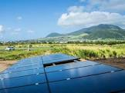
SOLAR ENERGY

Slide 7
May 01 2016 to May 01 2017

Slide 8
May 03 to June 01 2017

Slide 9
June 01 2017

Slide 10
DIFFICULTIES OF SOLAR ENERGY
Intermittent
Takes up a lot of space when land is limited
Costly venture
Output is small in the scheme of things – the 500kW farm at Frigate bay produce only 1/10 of 1% of the energy generated according to a SKELEC report

Slide 11
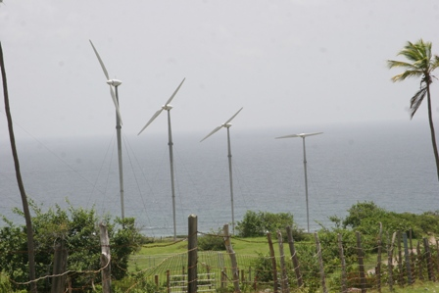
WIND ENERGY

Slide 12
MADDENS WIND FARM, NEVIS
Customer: WINDWATT
Wind Turbine: 8 Vergnet GEV MP-C, 230 kW, 32m rotor diameter, 55m hub height
Total power: 2.2 MW
Commissioned: 2010
Operations and Maintenance: Vergnet S.A.

Slide 13
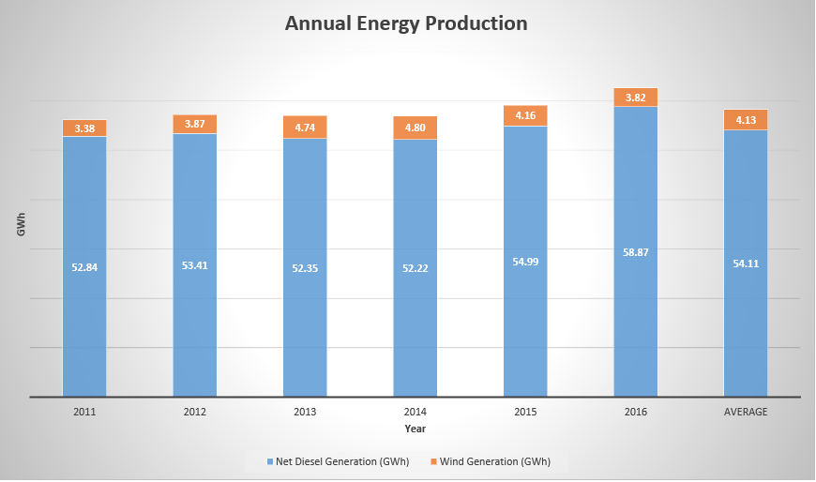
ANNUAL ENERGY PRODUCTION

Slide 14
DIFFICULTIES OF WIND ENERGY
Intermittent
Takes up a lot of space when land is limited
Costly venture
Output is small in the scheme of things – the 2.2MW farm at Madderns produce less than 1% of the energy generated.

Slide 15
SUSTAINABILITY OF SOLAR & WIND ENERGY
Both form of energy are sustainable

Slide 16
HOW CAN DEVELOPING RENEWABLE TECHNOLOGIES BE INTEGRATED EFFECTIVELY?
Education
Increase roof-top applications
After implementing energy efficiency
Localized and remote location application
Partnering with other technologies to increase grid integration such as smart grid technology
Introduction of Net-metering by utilities

Slide 17
QUESTIONS?

Slide 18
THANK YOU!!

